Slide 1
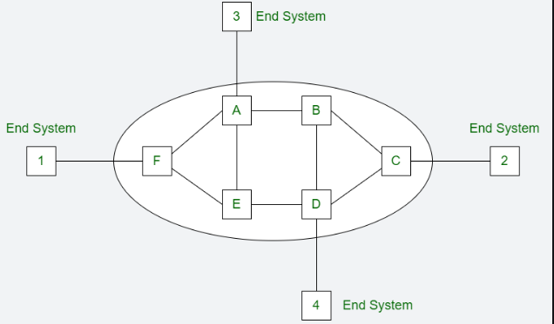
Congestion Control in Virtual Subnets
Virtual Circuit is the computer network providing connection-oriented service. It is a connection-oriented network.
In virtual circuit resource are reserve for the time interval of data transmission between two nodes. This network is a highly reliable medium of transfer. Virtual circuits are costly to implement.
500

Slide 2
Congestion Control in Virtual Subnets
Once the congestion is detected in virtual circuit network, closed-loop techniques is used. There are different approaches in this technique:
No new connection
No new connections are established when the congestion is detected. This approach is used in telephone networks where no new calls are established when the exchange is overloaded.
Participation of congested router invalid
Another approach to control congestion is allow all new connections but route these new connections in such a way that congested router is not part of this route.
Negotiation
To negotiate different parameters between sender and receiver of the network, when the connection is established. During the set up time, host specifies the shape and volume of the traffic, quality of service and other parameters.
500

Slide 3
Congestion Control in Virtual Subnets
Advantages of Virtual Circuit:
Packets are delivered to the receiver in the same order sent by the sender.
Virtual circuit is a reliable network circuit.
There is no need for overhead in each packet.
Single global packet overhead is used in virtual circuit.
Disadvantages of Virtual Circuit:
Virtual circuit is costly to implement.
It provides only connection-oriented service.
Always a new connection set up is required for transmission.
500

Slide 4
Congestion Control in Datagram Subnets
Congestion Control approaches which can be used in the datagram Subnet (and also in virtual circuit subnets) are :
Warning Bit, Choke packets, Load shedding, << Congestion Detection and Recovery >>
Random early discard, Traffic shaping << Congestion avoidance >>
Warning Bit : A special bit in the packet header is set by the router to warn the source when congestion is detected. The bit is copied and piggy-backed on the ACK and sent to sender.
The sender mentions the number of ACK (acknowledgment) packets, it receives with the warning bit set and adjusts its transmission rate accordingly.
This can reduce the transmission rate, increasing the packet size or some measure to reduce the load on the network.
Explicit Congestion notification (2bits in IP haeader), Congestion warning (Network ), Congestion Notification bit( Congestion is severe).
500

Slide 5
Congestion Control in Datagram Subnets
Choke Packets :
A choke packet is control packet generated at congested node and transmitted to restrict traffic flow. The source, one receiving the choke packet must reduce its transmission rate by a certain percentage.
This approach can be used in virtual circuits as well as in the datagram sub-nets. In this technique, each router associates a real variable with each of its output lines.
This real variable says it has a value between 0 and 1, and it indicates the percentage utilization of that line. If the value of the variable goes above the threshold then the output line will enter into a warning state.
The router will check each newly arriving packet to see if its output line is in the warning state. if it is in the warning state then the router will send back choke packets. Several variations on the congestion control algorithm have been proposed depending on the value of thresholds.
Depending upon the threshold value, the choke packets can contain a mild warning a stern warning, or an ultimatum. Another variation can be in terms of queue lengths or buffer utilization instead of using line utilization as a deciding factor.
500

Slide 6
Congestion Control in Datagram Subnets
How Choke Packets :
A network device detects congestion in the network.
The device sends a choke packets to the sender indicating the congestion.
The sender receives the choke packet and reduces its transmission rate.
The network device continues to monitor the congestion and sends additional choke packets as needed.
When the congestion clears, the network device sends a clear packet to the sender indicating that it can resume its normal operation.
Merits : Prevent network congestion collapse, Promote fair sharing of bandwidth, Ensure reliable data transmission.
Drawback:
The problem with the choke packet technique is that the action to be taken by the source host on receiving a choke packet is voluntary and not compulsory.
500

Slide 7
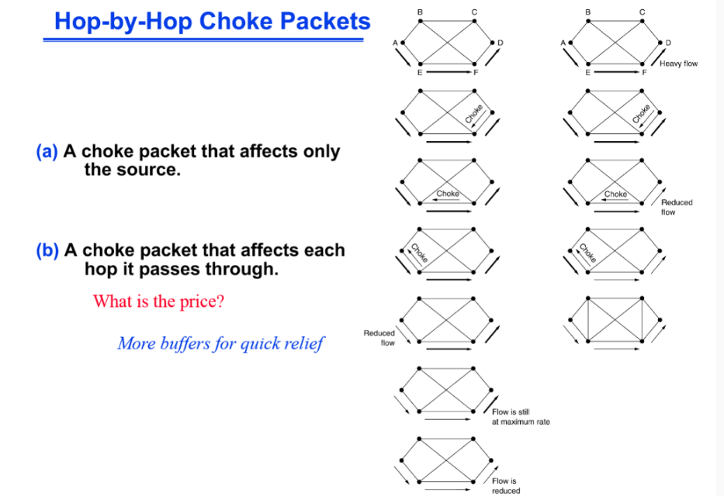
Congestion Control in Datagram Subnets
500

Slide 8
Congestion Control in Datagram Subnets
Load Shedding :
Admission control, choke packets, and fair queuing are the techniques suitable for congestion control. But if these techniques cannot make the congestion disappear, then the load-shedding technique is to be used.
The principle of load shedding states that when the router is inundated by packets that it cannot handle, it should simply throw packets away.
A router flooded with packets due to congestion can drop any packet at random. But there are better ways of doing this.
The policy for dropping a packet depends on the type of packet. For file transfer, an old packet is more important than a new packet In contrast, for multimedia, a new packet is more important than an old one So.
The policy for file transfer is called wine (old is better than new), and that for the multimedia is called milk (new is better than old).
500

Slide 9
Congestion Control in Datagram Subnets
Load Shedding:
An intelligent discard policy can be decided depending on the applications. To implement such an intelligent discard policy, cooperation from the sender is essential.
The application should mark their packets in priority classes to indicate how important they are.
If this is done then when the packets are to be discarded the routers can first drop packets from the lowest class (i.e. the packets which are least important).
Then the routers will discard the packets from the next lower class and so on. One or more header bits are required to put the priority to make the class of a packet.
In every ATM cell, 1 bit is reserved in the header for marking the priority. Every ATM cell is labeled either as a low priority or high priority.
500

Slide 10
Congestion Control in Datagram Subnets
Random Early Detection :
RED is among the first Active Queue Management (AQM) algorithms. RED was proposed in 1993 by Sally Floyd. RED is called by three different names; a.k.a Random Early Discard or Random Early Drop and Random Early Detection (so there are 3 possible full forms of RED). The main goal of RED is to:
Avoid congestion: Passive Queue Management suffers from this problem. AQM detects the congestion beforehand and avoids it.
Avoid the problem of global synchronization: Passive Queue Management suffers from this problem. AQM avoids this problem.
Avoid the problem of lockout: The short-lived flows suffer the problem of lockout when long-lasting flows occupy the buffers of routers all the time. AQM solves this problem, now short-lived flows can get space in the buffer.
Maximize the ‘Power’ function, which is the ratio of throughput to delay: AQM handles the buffer queue properly, therefore there will no packet loss, as a result, there will be no retransmission of packets. The flow will be fluent and the delay will be minimum.
500

Slide 11
Congestion Control in Datagram Subnets
RED operates during the ‘enqueue’ time. It works at the output port during enqueue time, do not confuse this with ‘input port’ in the router architecture.
RED runs on the ‘output port’, but during the ‘enqueue’ time! RED operates ‘on the arrival of every packet’. Hence, there is no periodic time interval in which RED is invoked.
If packets are arriving at a lower speed then RED is invoked at a lower speed. If packets do not arrive, RED algorithm is not invoked. RED decides whether the incoming packet should be enqueued or dropped.
When a new packet arrives, RED makes a decision; whether this packet should be enqueued or dropped. It makes this decision even if there is space in the queue.
It makes this decision because if enqueuing the packet increases overall delay or makes the queue full then it will cause the congestion to occur.
If RED drops the packet before the queue is full then the sender will know about it indirectly and it will reduce its congestion window size and thus it avoids the congestion to happen in the future.
500

Slide 12
Congestion Control in Datagram Subnets
How RED Works:
Monitor the network and queue size.
Calculate the average queue size and compare it to a threshold
If the queue size is exceeds the threshold, randomly drop the packets with a certain probability.
The probability of dropping packets increases as the queue size grows.
Red helps in Prevent Congestion, reduce packet loss, improve network fairness, Improves the overall network performance.
500

Slide 13
Congestion Control in Datagram Subnets
RED operates during the ‘enqueue’ time. It works at the output port during enqueue time, do not confuse this with ‘input port’ in the router architecture.
RED runs on the ‘output port’, but during the ‘enqueue’ time! RED operates ‘on the arrival of every packet’. Hence, there is no periodic time interval in which RED is invoked.
If packets are arriving at a lower speed then RED is invoked at a lower speed. If packets do not arrive, RED algorithm is not invoked. RED decides whether the incoming packet should be enqueued or dropped.
When a new packet arrives, RED makes a decision; whether this packet should be enqueued or dropped. It makes this decision even if there is space in the queue.
It makes this decision because if enqueuing the packet increases overall delay or makes the queue full then it will cause the congestion to occur.
If RED drops the packet before the queue is full then the sender will know about it indirectly and it will reduce its congestion window size and thus it avoids the congestion to happen in the future.
500

Slide 14
Congestion Control in Datagram Subnets
Jitter control :
Jitter refers to the variation in the arrival times of packets or data packets in a network, typically in a network with variable latency.
High Jitter: This occurs when there is significant variability in the arrival times of packets or data. High jitter can cause issues such as packet loss, delays, and poor quality in real-time applications like VoIP (Voice over Internet Protocol) or video conferencing. It indicates instability or inconsistency in the network performance.
Low Jitter: Low jitter means that there is minimal variation in the arrival times of packets or data. Networks with low jitter are considered more stable and predictable, providing a smoother experience for real-time applications and ensuring reliable data transmission.
In summary, while high jitter indicates instability and variability in network performance, low jitter signifies stability and consistency, which are crucial for the smooth operation of real-time applications and overall network reliability.
500

Slide 15
Congestion Control in Datagram Subnets
Jitter control :
The real-time audio and video cannot tolerate jitter on the other hand the jitter doesn’t matter if the packets are carrying information contained in a file.
For the audio and video transmission, if the packets take 20 ms to 30 ms delay to reach the destination, it doesn’t matter, provided that the delay remains constant.
The quality of sound and visuals will be hampered by the delays associated with different packets having different values. Therefore, practically we can say that 99% of packets should be delivered with a delay ranging from 24.5 ms to 25.5 ms.
When а packet arrives at a router, the router will check to see whether the packet is behind or ahead and by what time.
This information is stored in the packet and updated at every hop. If a packet is ahead of the schedule then the router will hold it for a slightly longer time and if the packet is behind schedule, then the router will try to send it out as quickly as possible.
This will help in keeping the average delay per packet constant and will avoid time jitter.
500

Slide 16
Congestion Control in Datagram Subnets
Jitter Control:
Here is a quick breakdown of what is considered normal jitter for the internet:
Very good: Less than 10 ms
Good: 10 ms to 20 ms
Normal: 20 ms to 50 ms
Bad: 50 ms to 100 ms
Very bad: More than 100 ms
Bad Network Jitter issues:
Voice over Internet Protocol (VoIP) calls: It causes disruptions, leading to distorted audio and difficulty understanding conversations.
Video conferencing: It results in choppy video playback, making following discussions and nonverbal cues challenging.
Online gaming: In gaming, even small delays caused by jitter can affect the responsiveness of controls, leading to a frustrating and laggy experience.
Real-time data transmission: Applications relying on real-time data, such as financial trading or remote monitoring, can experience inconsistencies due to the deviation in the network signal pulses, potentially leading to costly error.
500

Slide 17
Congestion Control in Datagram Subnets
Jitter Control :
While jitter, latency, and ping are interconnected, they represent distinct aspects of network performance.
Latency refers to the delay caused by jitter in the network, resulting in the uneven delivery of data packets. It is the delay between sending and receiving data packets.
Ping, on the other hand, measures the round-trip time for a packet to reach its destination and return.
Jitter, as mentioned earlier, focuses on the variation in packet arrival times. A jitter buffer is a mechanism used to manage and smooth out variations in packet arrival times.
500

